Slide 1


Slide 2

Contents
about us
idea
technologies
implementation
demo

Slide 3
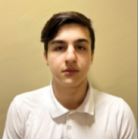
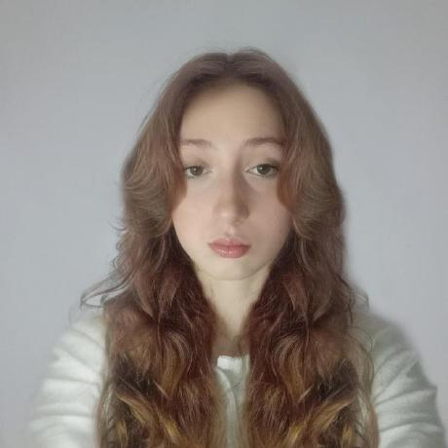
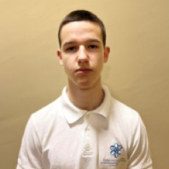
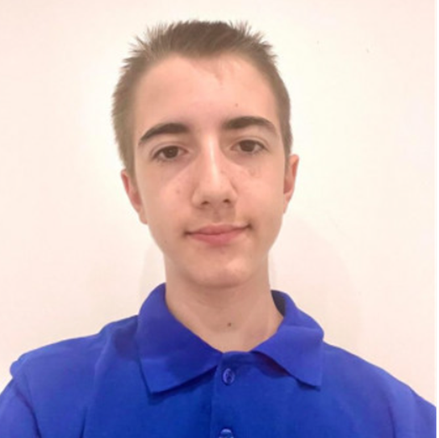
About us
Ivan Stoychev
Maria Koleva
Backend developer
Scrum trainer
Ivelin Bozhilov
Stelian Mikov
Frontend developer
QA engineer

Slide 4
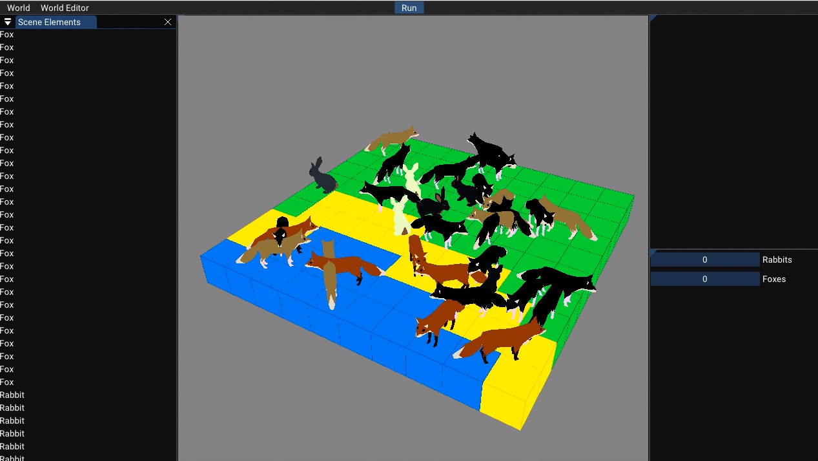
Our idea
Our idea was to make an ecosystem simulator
where you watch the evolution of rabbits and foxes.

Slide 5

















Technologies

Slide 6
Now let’s check out a quick demo

